Slide 1
ClimbCode
Notes:
Welcome to ClimbCode’s exposition. Here we’ll see the results of the development’s second sprint of this project.

Slide 2

Our Path Today
Idea
Technologies & Work
Things Done
Things in Progress
Things to do
Conclusions
2
Notes:
This is the path we’re going to follow during the presentation. First we’ll introduce the idea behind ClimbCode, next we’ll see the technologies we’re using to develop ClimbCode, after that, we’ll talk about the things we’ve done, the ones we’re doing and the ones we’re going to do. Finally, we’ll see some conclusions for our project.

Slide 3
Idea
Notes:
We’ll start seeing which idea lies behind ClimbCode. But first, let me introduce two facts:

Slide 4
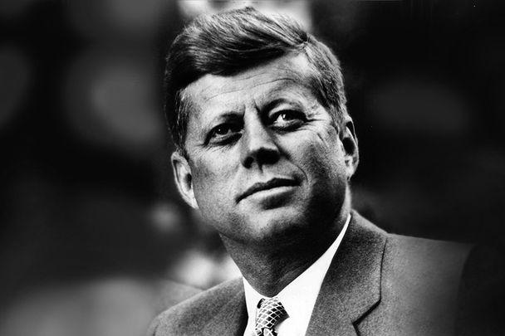
4
Notes:
As JFK said: ”Let us think of education as the means of developing our greatest abilities”. I’m sure we all think that is by the education how we improve ourselves and become better people each day that passes, right?

Slide 5

5
Notes:
Then let’s see the other concept. As Steve Jobs said: ”Computers themselves, and software yet to be developed, will revolutionize the way we learn”. To prove this, we only have to see systems like our blackboard system or the digital blackboards used in schools, thanks to the software and its development.

Slide 6

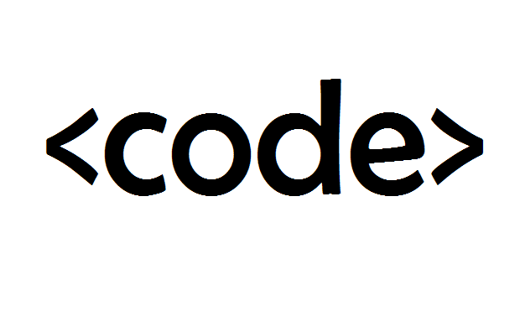
Idea
+
=
ClimbCode
6
Notes:
Then what would happen if we combined those two apparently independent concepts: Education and Software? The answer to this is ClimbCode, our web platform, which acts as a supporting tool for teaching with the help of programming and software.

Slide 7


Idea
Interactive
7
Notes:
How do we grant this support? Simple, by interactive exercises, a better version of the original paper exercises made by independent programmers. Those exercises are bought by schools in order to increase their content catalog they have for supporting their subjects.

Slide 8

Learn Programming?
8
Notes:
But then, is it imperative to know programming to use our platform as a school? That is a question whose answer can be a little controversial. We’ll see its answer once we talk about the feedback we’ve got during our pilot plan.

Slide 9
Technologies & Work
Notes:
Ahora hablaremos de la metodología de trabajo que estamos siguiendo para desarrollar el proyecto, así como la tecnología que estamos utilizando.

Slide 10

Work Methodology
SCRUM
10
Notes:
Para desarrollar nuestro proyecto hemos adaptado a nuestra forma de trabajo la metodología SCRUM mencionada en la asignatura, haciendo reuniones semanales para ver el desarrollo del proyecto, repartir tareas y discutir elementos de desarrollo y gestión, siempre basándonos en los sprints, el product backlog y el sprint backlog propio de SCRUM.

Slide 11




Technologies
Development:
11
Notes:
For the main development of our project, we’re using PostgreSQL, Django and Python for our back-end, and Bootstrap for our front-end.

Slide 12


Technologies
Deployment:
12
Notes:
For the deployment of the project, we’ve used mainly Digital Ocean, but at first we approached to Heroku before we discovered that it wasn’t as good as Digital Ocean in response times and availability. Despite that, we still have a version deployed in heroku in case that the Digital Ocean one doesn’t work.

Slide 13




Technologies
Interactive Exercises:
13
Notes:
For the interactive exercises’ system, we’re using JavaScript, with Ace for a little help with the syntax, Chart.js for creating the graphics and pictures for the exercises and AJAX.

Slide 14

Technologies
Knowledge:
14
Notes:
Finally, for our knowledge management we’re using a git repository hosted in GitHub.

Slide 15

Technologies’ Status
TECH. FEATURE
RISKS
LEARNING
15
Notes:
The situation of these technologies is the one shown in these tables. As we can see, we’re comparing the risks of using each technology right now in our project and the status of its learning process. The green colour means that either the learning is completed and we absolutely can use that technology without any risks or that there is no risk in using that technology in our project at the moment.
The blue colour means that currently we’ve learnt all we needed from that technology, but there are a couple of features we don’t fully control, which aren’t cricital or necessary for our project. Also, it means that using the technology in our project could carry a little risk if we find problems during its usage.
Finally, the red colour means that the technology isn’t learnt and that using the technology has many risks for our project, resulting in possible delays in its development.

Slide 16

Technologies’ Status
TECH. FEATURE
RISKS
LEARNING
16
Notes:
As we can see, we’ve learnt all we needed from many technologies. The situation of AJAX and Chart.js is that despite knowing the needed things for the project, we still don’t know little features that could improve a little the project itself rather than stopping its development.

Slide 17
Technologies’ Status
TECH. FEATURE
RISKS
LEARNING
17
Notes:
Here, we can see the only real problem that could appear in our project: The situation in which our main deployment technology, Digital Ocean, fails, because in that case, using Heroku could result in serious problems of availability for our platform, because of its slow response times.

Slide 18
Things Done
Notes:
Now we’ll see the things we’ve already done in our project.

Slide 19



Problems’ Status
PROBLEM | SOLUTION | METRIC | RESULT
 |  | TOTAL PROBLEMS (> 0) | Before: 0 After: 3
 | SP & PRIORITIES | ESTIMATION ERROR (< 25%) | Before: 36% After: 15%
19
Notes:
First, we’ve been analysing our problems and the solutions given to them, resulting in this table we see here. The table shows our principal problems: The first is the fact that we found difficult to document the problems we previously found. To solve it we decided to create a document in which we could put all the problems we could find during the development process. As we see, measuring the problems documented per week we can see that the problem has been completely solved, because the number of problems documented has increased, staying above the ratio of 0 we considered as the minimum acceptable level for this metric.
The second problem is that we found hard to estimate our tasks, so we decided to put Story Points on our requirements and relate them to our tasks, measuring the error between the estimations and the real time invested in those tasks. In addition, to increase the efficiency of the tasks’ distribution, we’ve also put a priority for each task, allowing them to be distributed better and lowering our metric. The result of this is that la desviación ha disminuido, but still we need to keep improving this system in order to mantener la métrica en estos valores el máximo tiempo posible.

Slide 20


Problems’ Status
PROBLEM | SOLUTION | METRIC | RESULT
 |  | BIG TASKS (< 10%) | Before: 22% After: 17%
20
Notes:
Finally, the other problem we’ve tried to solve was that there were many big and indivisible tasks, so we decided to find ways to divide them and make them lighter and smaller. To measure the success of this solution we used the percentage of big tasks (more than 3 estimated hours) we have in our project, showing that the solution is working at the moment and the problem seems solved, but still needs to decrease to a 10%, which is the accepted limit for it.

Slide 21
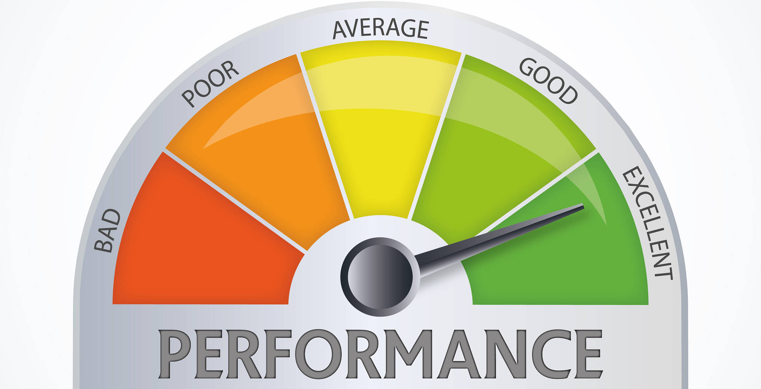
Performance
COMPLETED SP / REAL TOTAL HOURS
21
Notes:
We’ve also updated our metric to measure the performance of our team members in matters of tasks. The new version of the metric uses the current completed story points done by the member in the sprint, and the total amount of hours spent by that member for doing those story points, resulting in a percentage which shows the performance of the team member based on his tasks completed during the week and the hours spent on them.

Slide 22


Features
Interactive
22
Notes:
We’ve also finished many features of our project, including the basic CRUDS and the creation of interactive exercises proposed in sprint 1, the persistence of those exercises in our database, an update for our welcome page and the style of the whole platform…

Slide 23




Features
23
Notes:
The whole license’s system, allowing schools to register in our system choosing the license they want, many other little use cases in our Django Model, the main part of our transaction’s system, some issues related with security y la posibilidad de registrar automáticamente profesores y alumnos en el sistema mediante un archivo csv.

Slide 24


Pilot Plan
24
Notes:
Finally, we’ve been applying our pilot plan, speeding it up by finishing the meetings with programmers and obtaining their feedback and starting doing meetings with schools, our main source of income and obtaining feedback from them, too. En estas reuniones se les ha mostrado los casos de uso estrella para que diesen su opinión. También se les ha enseñado el sistema de creación de ejercicios interactivos, se les ha pedido sugerencias de mejora y se les ha preguntado sobre los precios de la plataforma.

Slide 25


Pilot Plan’ Results
25
Notes:
De este feedback hemos decidido por ahora aplicar los dos más solicitados por los clientes, que consisten en el registro automatizado de alumnos y profesores con un documento csv y el mantenimiento de forma segura de los datos de los alumnos. Respondiendo a nuestra pregunta inicial de si es necesario programar para usar nuestra plataforma, los clientes nos han respondido que no presentan tanto interés en tener en ella ningún mecanismo para aprender o fomentar la programación en el ámbito escolar, ya que prefieren centrarse en los ejercicios interactivos y su uso.

Slide 26
Deployment & Demo
Deployment URL: www.climbcode.tk
Demo URL:
https://youtu.be/3YsYJetMqHo
26
Notes:
To show how the system works today, we’ve put a link in which everyone can see our project, and also we’ve created a demo, showing our star use case: The creation and buying of an interactive exercise. https://youtu.be/3YsYJetMqHo

Slide 27


Everyone’s Tasks
EVERYONE
5h 30min
27
Notes:
Talking now about the concrete tasks done by the team, everyone in the sprint has participated in meetings whose objective was to review the presentations of the sprint and see how the project was developing. That resulted in a total of 5 hours and 30 minutes per member.

Slide 28
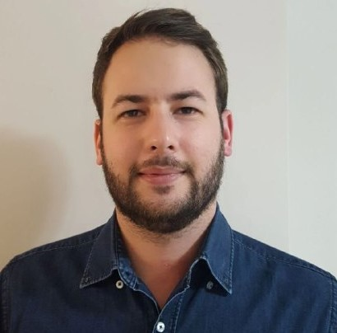

Personal Tasks
Alejandro Román, Project Manager
ESTIMATED
REAL
 | 21h | 17h
TASKS | 2h | 2h 15min
PROGRESS: 74% PERFORMANCE: 65%
28
Notes:
Now speaking member by member, Alejandro Román, our project manager, has been working this sprint in the tasks’ distribution and in the notebook’s read-only view, solving the problems left by last sprint and correcting its bugs. That resulted in a 74% of the progress of the task and a performance of 65% during this week.

Slide 29



Personal Tasks
Álvaro Domínguez, Business Manager
ESTIMATED
REAL
 | 10 h | 3h 40 min
 | 2h | 10 min
 | 5h | 5h 16 min
29
Notes:
Álvaro Domínguez, our business manager, has been working this sprint creating the two presentations done in it, their respective upgrade reports, the application of the pilot plan…

Slide 30
Personal Tasks
Álvaro Domínguez, Business Manager
ESTIMATED
REAL
WELCOME PAGE | 1 h | 47 min
CONTINGENCY PLAN | 1h | 23 min
PROGRESS: 57% PERFORMANCE: 130%
30
Notes:
The upgrade of our welcome page and the creation of the contingency plan. That resulted in a 57% of the progress of the task and a performance of 130% during this week.

Slide 31
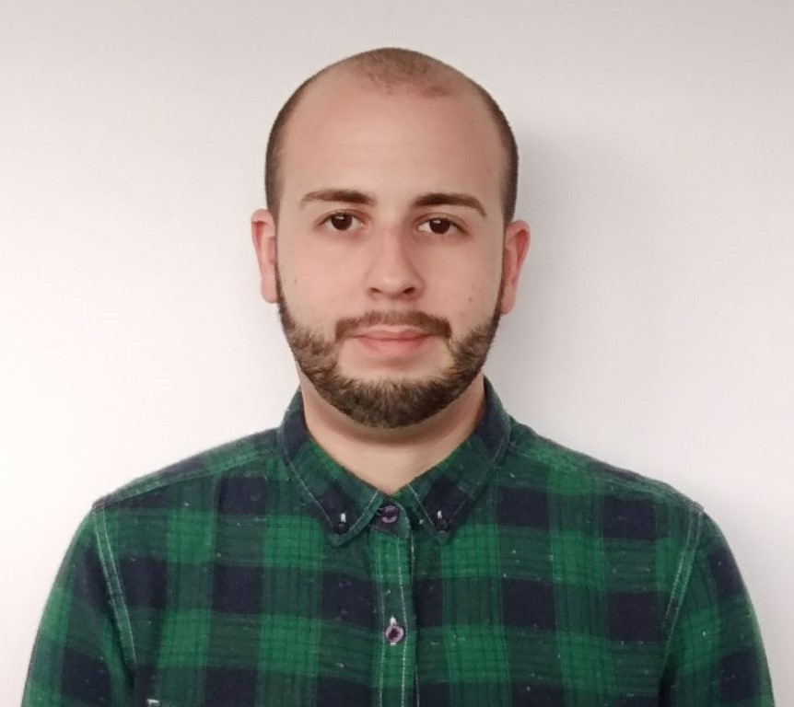

Personal Tasks
Miguel Ángel Baños, Front-End Developer
ESTIMATED
REAL
 | 18h | 20h
 | 8h | 10h
PROGRESS: 96% PERFORMANCE: 86%
31
Notes:
Pasando ahora a nuestros desarrolladores de Front-End, Miguel Ángel Baños ha estado trabajando en la solución de algunas incidencias de seguridad de los ejercicios interactivos, estableciendo un IFrame Sandbox y expresiones regulares en las partes de código editable para evitar que código malicioso acceda al DOM de nuestra página o persista en la base de datos. para evitar. Además, ha trabajado en los bugs aparecidos en el notebook, los problemas que quedan del sprint anterior y la vista de sólo lectura. Ha tenido esta semana un rendimiento del X%, completando un 96% de sus tareas.

Slide 32
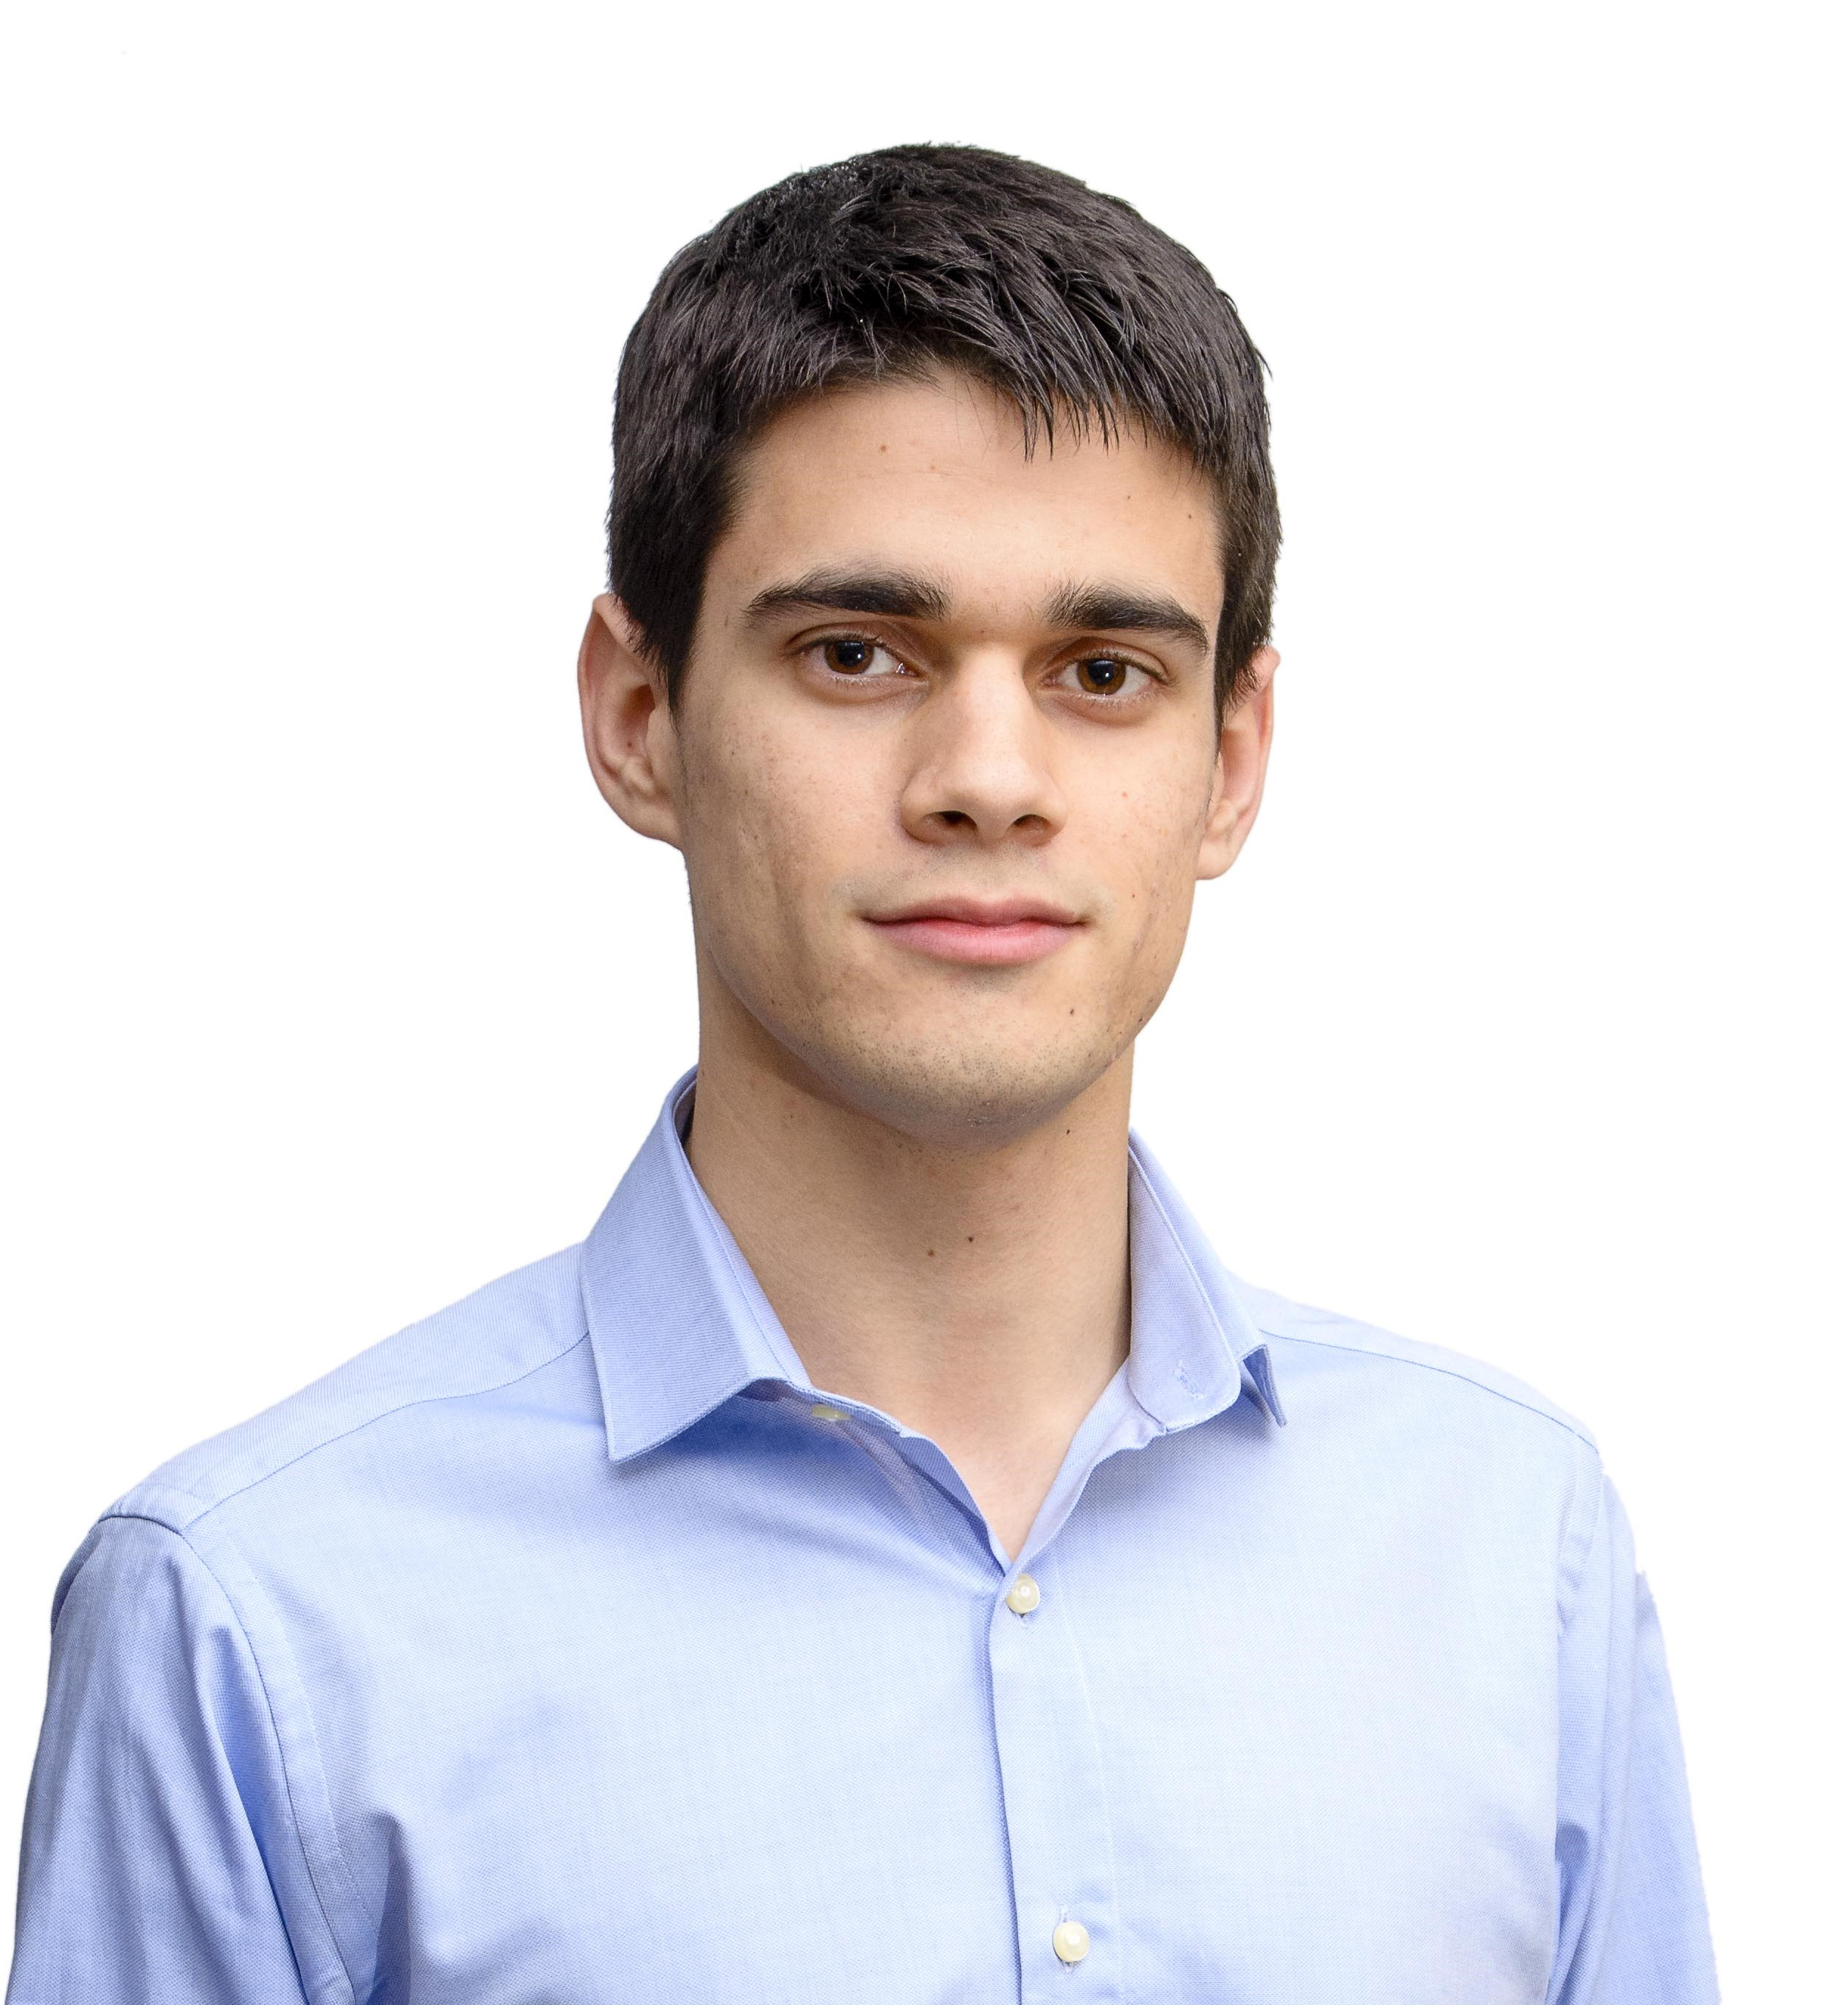
Personal Tasks
Alejandro Garrido, Front-End Developer
ESTIMATED
REAL
 | 18 h | 7h
METRICS | 1h | 30min
PROGRESS: 45% PERFORMANCE: 85%
32
Notes:
Alejandro Garrido ha estado trabajando en la actualización de la navegabilidad y el estilo de la plataforma, así como en la gestión y actualización de métricas del equipo de trabajo. Ha tenido esta semana un rendimiento del 85%, completando un 45% de sus tareas.

Slide 33
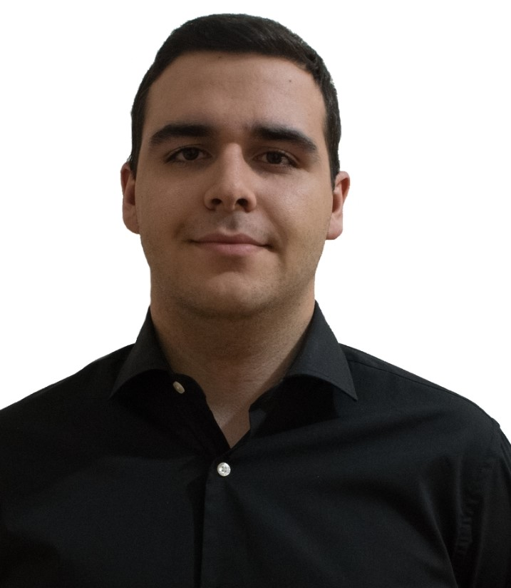
Personal Tasks
Andrés Ferández, Back-End Developer
ESTIMATED
REAL
 | 3 h | 2h 50min
 | 9h | 3h 16min
33
Notes:
Por último respecto a nuestros desarrolladores de Front-End, Andrés Fernández ha estado trabajando en la corrección de bugs en los casos de uso del modelo Django, el tratamiento de incidencias de seguridad en la plataforma…

Slide 34

Personal Tasks
Andrés Ferández, Back-End Developer
ESTIMATED
REAL
 | 9 h | 10h 45min
PROGRESS: 62% PERFORMANCE: 78%
34
Notes:
Y en la posibilidad de subir automáticamente con un excel profesores y alumnos y registrarlos en un centro. Ha tenido esta semana un rendimiento del 78%, completando un 62% de sus tareas.

Slide 35
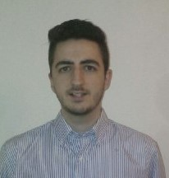

Personal Tasks
Jesús Sosa, Back-End Developer
ESTIMATED
REAL
 | 10h | 6h
 | 6h | 9h
 | 4h | 2h 30min
35
Notes:
Jesús Sosa ha estado trabajando en la elaboración de las demos del sprint, la corrección de bugs en los casos de uso del modelo Django, la solución de incidencias de seguridad…

Slide 36
Personal Tasks
Jesús Sosa, Back-End Developer
ESTIMATED
REAL
INTERACTIVE EXERCISES | 3 h | 2h 32min
PROGRESS: 44% PERFORMANCE: 52%
36
Notes:
Y la terminación de la batería inicial de ejercicios interactivos. Ha tenido esta semana un rendimiento del 52%, completando un 44% de sus tareas.

Slide 37
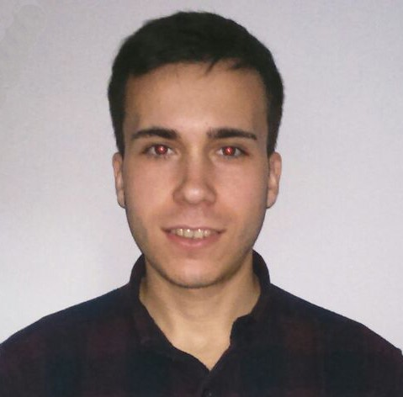
Personal Tasks
Álvaro Sánchez, Back-End Developer
ESTIMATED
REAL
 | 14h | 13h
 | 6h | 8h
PROGRESS: 75% PERFORMANCE: 71%
37
Notes:
Por último, Álvaro Sánchez ha estado trabajando en el sistema de transacciones y la corrección de bugs en los casos de uso del modelo Django. Ha tenido esta semana un rendimiento del 71%, completando un 75% de sus tareas.

Slide 38
Group’s Hour Deviation
38
Notes:
To see better the big picture behind the hours’ invested by each member, we have this graphic in which we can see the difference between the estimated hours and the real hours invested by each member during this sprint. As we see, the difference has significantly decreased since last time, but still there is work to do if we want to keep these figures.

Slide 39
Contingency Plan
Punishments
+
Team Building
+
Tasks’ Distribution
39
Notes:
Por último, hemos desarrollado un plan de contingencia en caso de haber problemas en el equipo de desarrollo. Dicho plan se basa en el uso de castigos en nuestras sesiones de team-building, apoyándose a su vez en nuestro sistema de recompensas, y una posterior reorganización de las tareas en caso de ser necesario. Todos los posibles problemas, además, serán tratados en reuniones urgentes específicas para ellos.

Slide 40
Things in Progress
Notes:
Now we’ll see the things we’re currently doing in our project.

Slide 41
Current Costs & Time
0%
50%
100%
€16K
900 h
€29K
1120 h
Current: €55%, 80% h
Budgeted: €50%, 50% h
41
Notes:
Currently we’ve spent a total amount of 900 hours and 16k euros, which is a 80 and a 55 percent from the total, and different from the 50 expected this week.

Slide 42
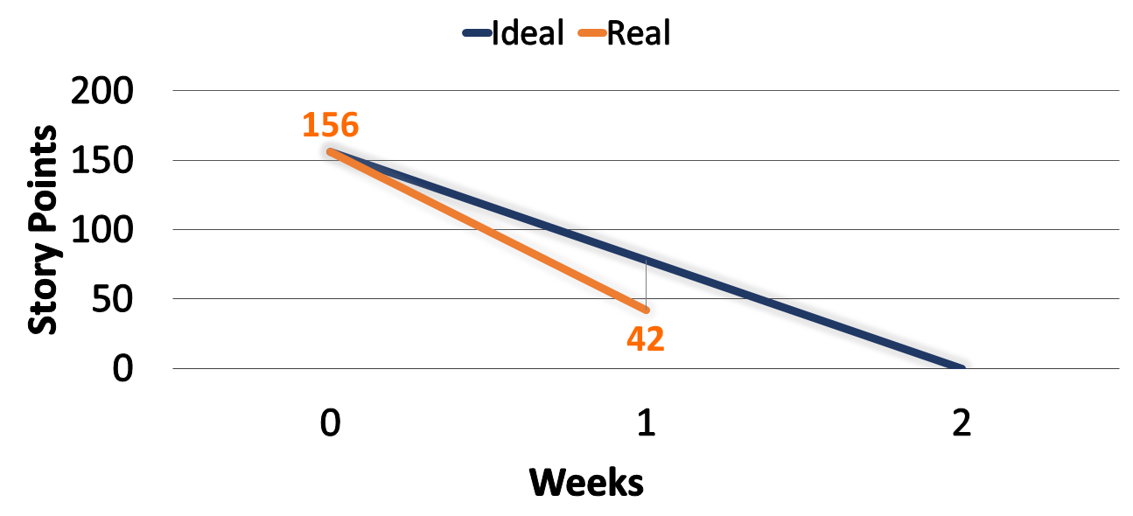
Current Sprint’s SP
42
Notes:
These hours and money investments are visible in these burndown graphics. The first one shows us the amount of Story Points done at this moment of the sprint, comparing it to the ideal development of the sprint itself. As we see, el desarrollo de este sprint va bastante mejor de lo esperado.

Slide 43
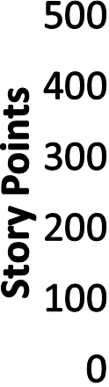
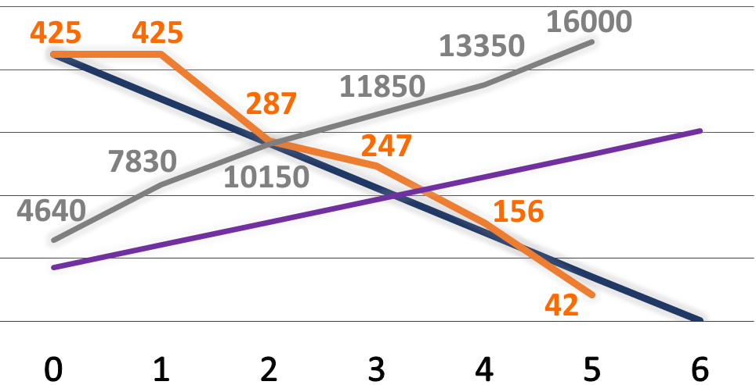
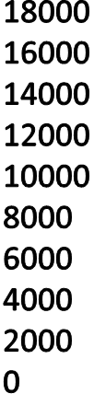

Current Project’s Situation
43
Notes:
The second graphic shows us the Story Points done during the full development of the project, comparing it with the remaining for the whole project and the ideal development of it. As we see, a pesar de que el desarrollo del proyecto va óptimo, los costes están bastante por encima del ideal.

Slide 44
Problems
STORY
POINTS
&
PRIORITIES
=
44
Notes:
Speaking now about the problems we’re facing, we are still working on the one mentioned before, using story points for our estimations. Despite the solution is fine and results in a improvement of our work, we still need to upgrade it and keep working on it so as we can have better numbers in terms of spent hours. For doing so, we’ve put into practice our priorities’ system mentioned before.

Slide 45

Features
45
Notes:
En cuanto a las funcionalidades en las que estamos trabajando, tenemos la actualización del estilo y la navegabilidad de la plataforma, el testeo de funcionalidades terminadas, terminar de implantar el sistema de transacciones, solucionar bugs en nuestro modelo django, solucionar incidencias de seguridad en nuestro proyecto y previsualizar ejercicios interactivos en las listas.

Slide 46
Features
Interactive
46
Notes:
En cuanto a las funcionalidades en las que estamos trabajando, tenemos la actualización del estilo y la navegabilidad de la plataforma, el testeo de funcionalidades terminadas, terminar de implantar el sistema de transacciones, solucionar bugs en nuestro modelo django, solucionar incidencias de seguridad en nuestro proyecto y previsualizar ejercicios interactivos en las listas.

Slide 47
Pilot Plan
Meeting with schools
47
Notes:
Finally, about our pilot plan, we’re still having meetings with teachers, getting all the feedback we can.

Slide 48
Things to do
Notes:
Now we’ll talk about the things we’re going to do in the future.

Slide 49

Problems
49
Notes:
First, and obviously, we’re going to keep reviewing our problems, their solutions and the result of their applications in our project.

Slide 50

Features
50
Notes:
Also, we’re going to develop a search system for our interactive exercises and we will complete our transaction’s system. We will test all the features done by then and solve all the security problems we can find, too.

Slide 51
Features
51
Notes:
Además, seguiremos trabajando en los bugs de nuestro modelo django.

Slide 52
Pilot Plan
Meeting with schools
52
Notes:
About our pilot plan, we’ll keep meeting with teachers if we’re allowed by our other tasks, getting more and more feedback.

Slide 53


Feedback Analysis
DASHBOARD
53
Notes:
Y además seguiremos analizando posible feedback implantable, como la posibilidad de corregir ejercicios interactivos, mostrar un dashboard con toda la actividad de los usuarios a los profesores y los propios alumnos, y la posibilidad de imprimir los ejercicios interactivos en formato PDF. Una vez analizadas las opciones, las que se acepten serán implantadas para el final del sprint.

Slide 54
Conclusions
Notes:
Finally, we’ll see some conclusions about the current situation of the project.

Slide 55
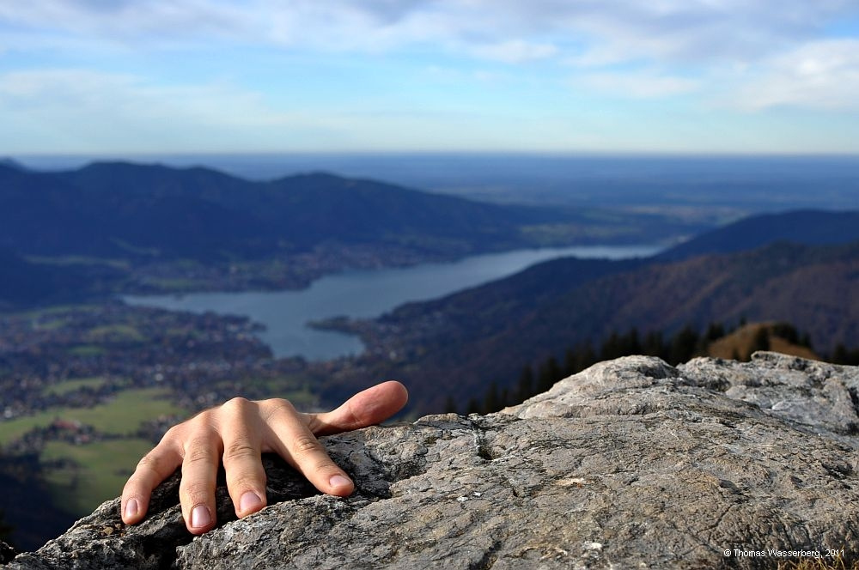
Conclusions
ALMOST THERE…
55
Notes:
A pesar de que lo que nos quedan son pinceladas sueltas de diferentes funcionalidades, el conjunto completo aún no está terminado. Sí es cierto que el núcleo principal de la plataforma está operativo, por lo que a pesar de tener trabajo por pulir y hacer, el avance del proyecto resulta positivo gracias a todo el esfuerzo que estamos poniendo el equipo de trabajo, al cual quiero felicitar.
Nos queda aún trabajo por hacer, y nuestra perspectiva es positiva a pesar de los baches que hemos tenido que superar.

Slide 56

THANKS!
You can find me at
alvdomnun@alum.us.es
56
Notes:
And that’s the end of our presentation! Thank you for watching, and if you have any doubt you can contact me at alvdomnun@alum.us.es.

